Slide 1
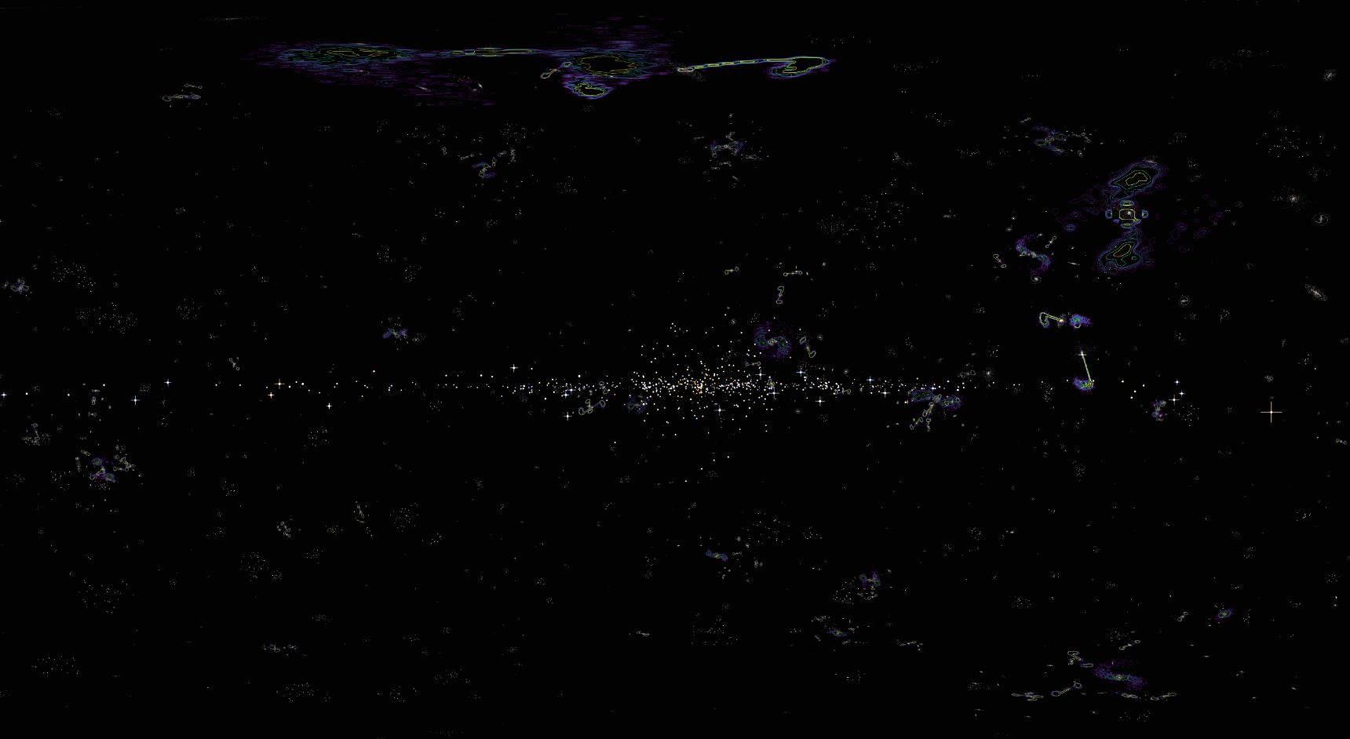
Distance Ladder Project Simulated Universe
Ryan White

Slide 2
Introduction
Really enjoyed the distance ladder project in PHYS3080
Started as an excuse to re-learn classes in Python
Ended up learning MKDocs, some multiprocessing, and lots of Matplotlib as well
Wanted to see where I could improve on the existing sim, and to add more features
Added features:
Radio lobes
AGN luminosity
Nebulae and nebulous galaxy gas (WIP)
Improved features:
Hubble galaxy types (SB/Sa-Sc, E0-E7 and S0)
Specific star populations by location within galaxy
More stars, more galaxies, more clusters!
Faster generation time (?) – potential for faster generation still
More realistic HR diagram features
Room for improvement, and some fixes needed

Slide 3
Structure of Presentation
The basic structure of the code
The physics of each aspect of the simulation
Future work (new features and areas of improvement)
How to `solve’ the simulation

Slide 4
Comparison with PHYS3080
 | This Simulation | Current PHYS3080 Sim
Galaxy Types | Full Hubble Classification | Disks (slight structure)
Galaxy Sizes | ~100pc, ~1000 stars | ~100pc, ~100 stars
Galaxy Clusters | ~10 per cluster, 1000 clusters (10% resolved, 90% distant) | ~30 per cluster, ~400 clusters (~2% resolved, 98% distant)
Galax. Features | Option for dark matter/black holes | Option for dark matter/black holes
Variable Stars | Min 2, option for 3 classes, wave types | 2 classes, wave types
HR Diagram | 4 star locations (MS, WD, Giant, SG) | 3 star locations (MS, WD, SG)
Universe Image | 1 All sky image | 6 directional sky images

Slide 5
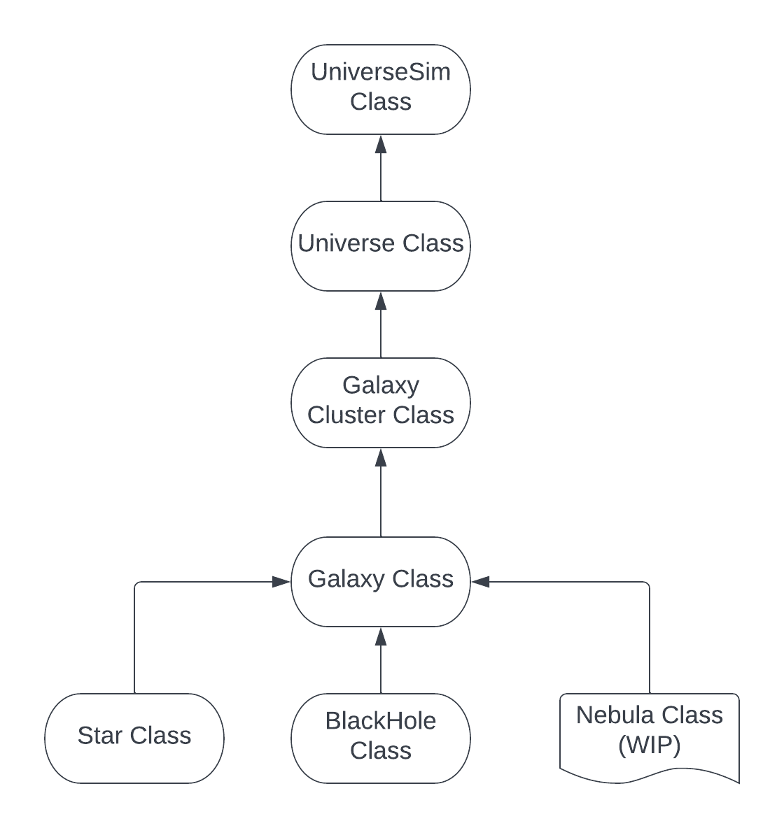
Basic Structure of Code
About ~3500 lines of code
All functions/classes have docstrings, and there is commenting throughout the code
User interacts with the UniverseSim class, which generates each universe object
Each class stores child objects within itself, to be used later
Universe properties trickle down, so that each object inherits universal properties (star variability, black holes, dark matter, etc)
Planning on splitting the Galaxy class in two (one for close, one for distant galaxies)

Slide 6
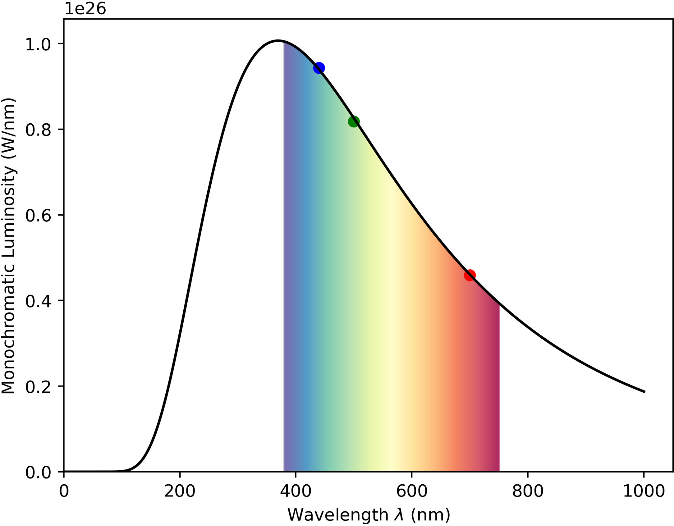
The Star Class — Outline
Four options in the star class:
“MS” – Main sequence
“WDwarf” – White dwarfs
“Giant” – Red giant and subgiant types
“SupGiant” — supergiant type stars
All stars are modelled via blackbody curves
All stars have a mass, radius and temperature – luminosity value follows

Slide 7
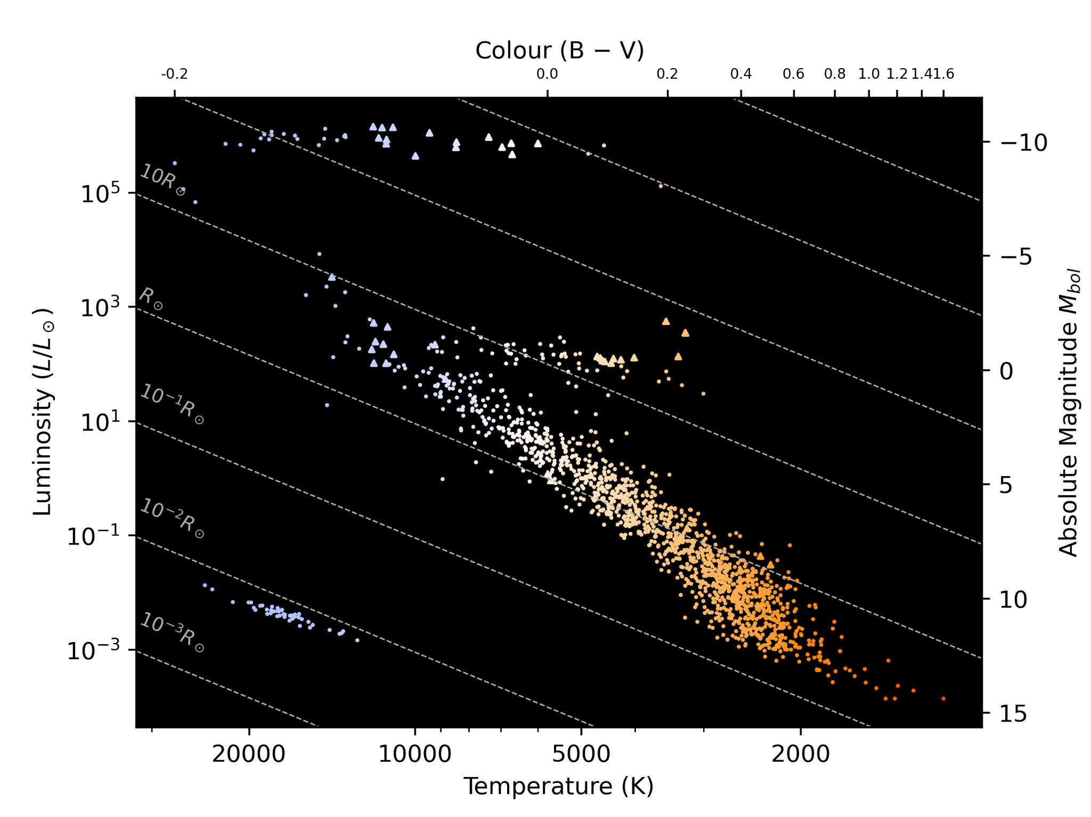
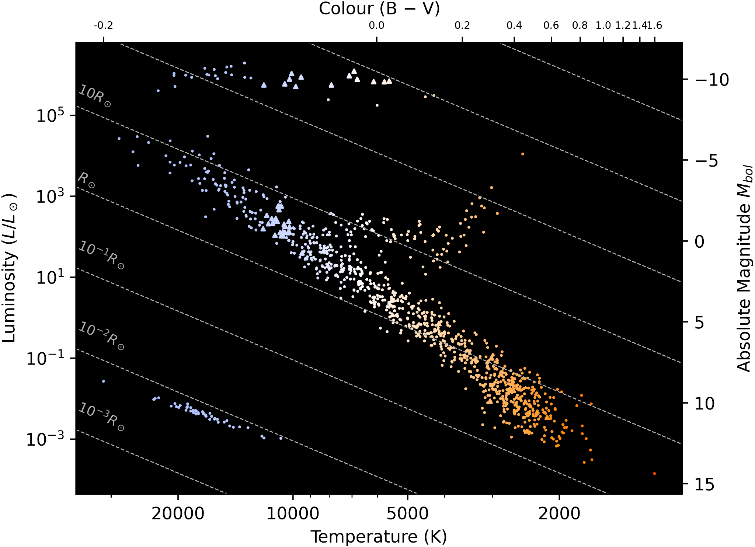
The Star Class — HR Diagram
Left: SBa galaxy. Right: E0 galaxy.
Main sequence masses decided by position within galaxy. Then, luminosity chosen by mass-luminosity relation
MS radii chosen by mass-radius relations, with scatter between ZAMS and TAMS
WD masses chosen from real distributions, radius from R ~ M^(⅓) relation
Giants and supergiants have trial-and-error found distributions to get decent looking results

Slide 8
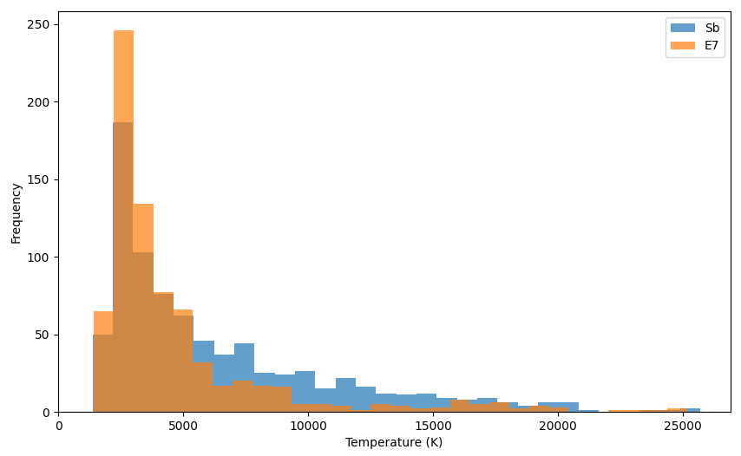
The Star Class — HR Diagram

Slide 9
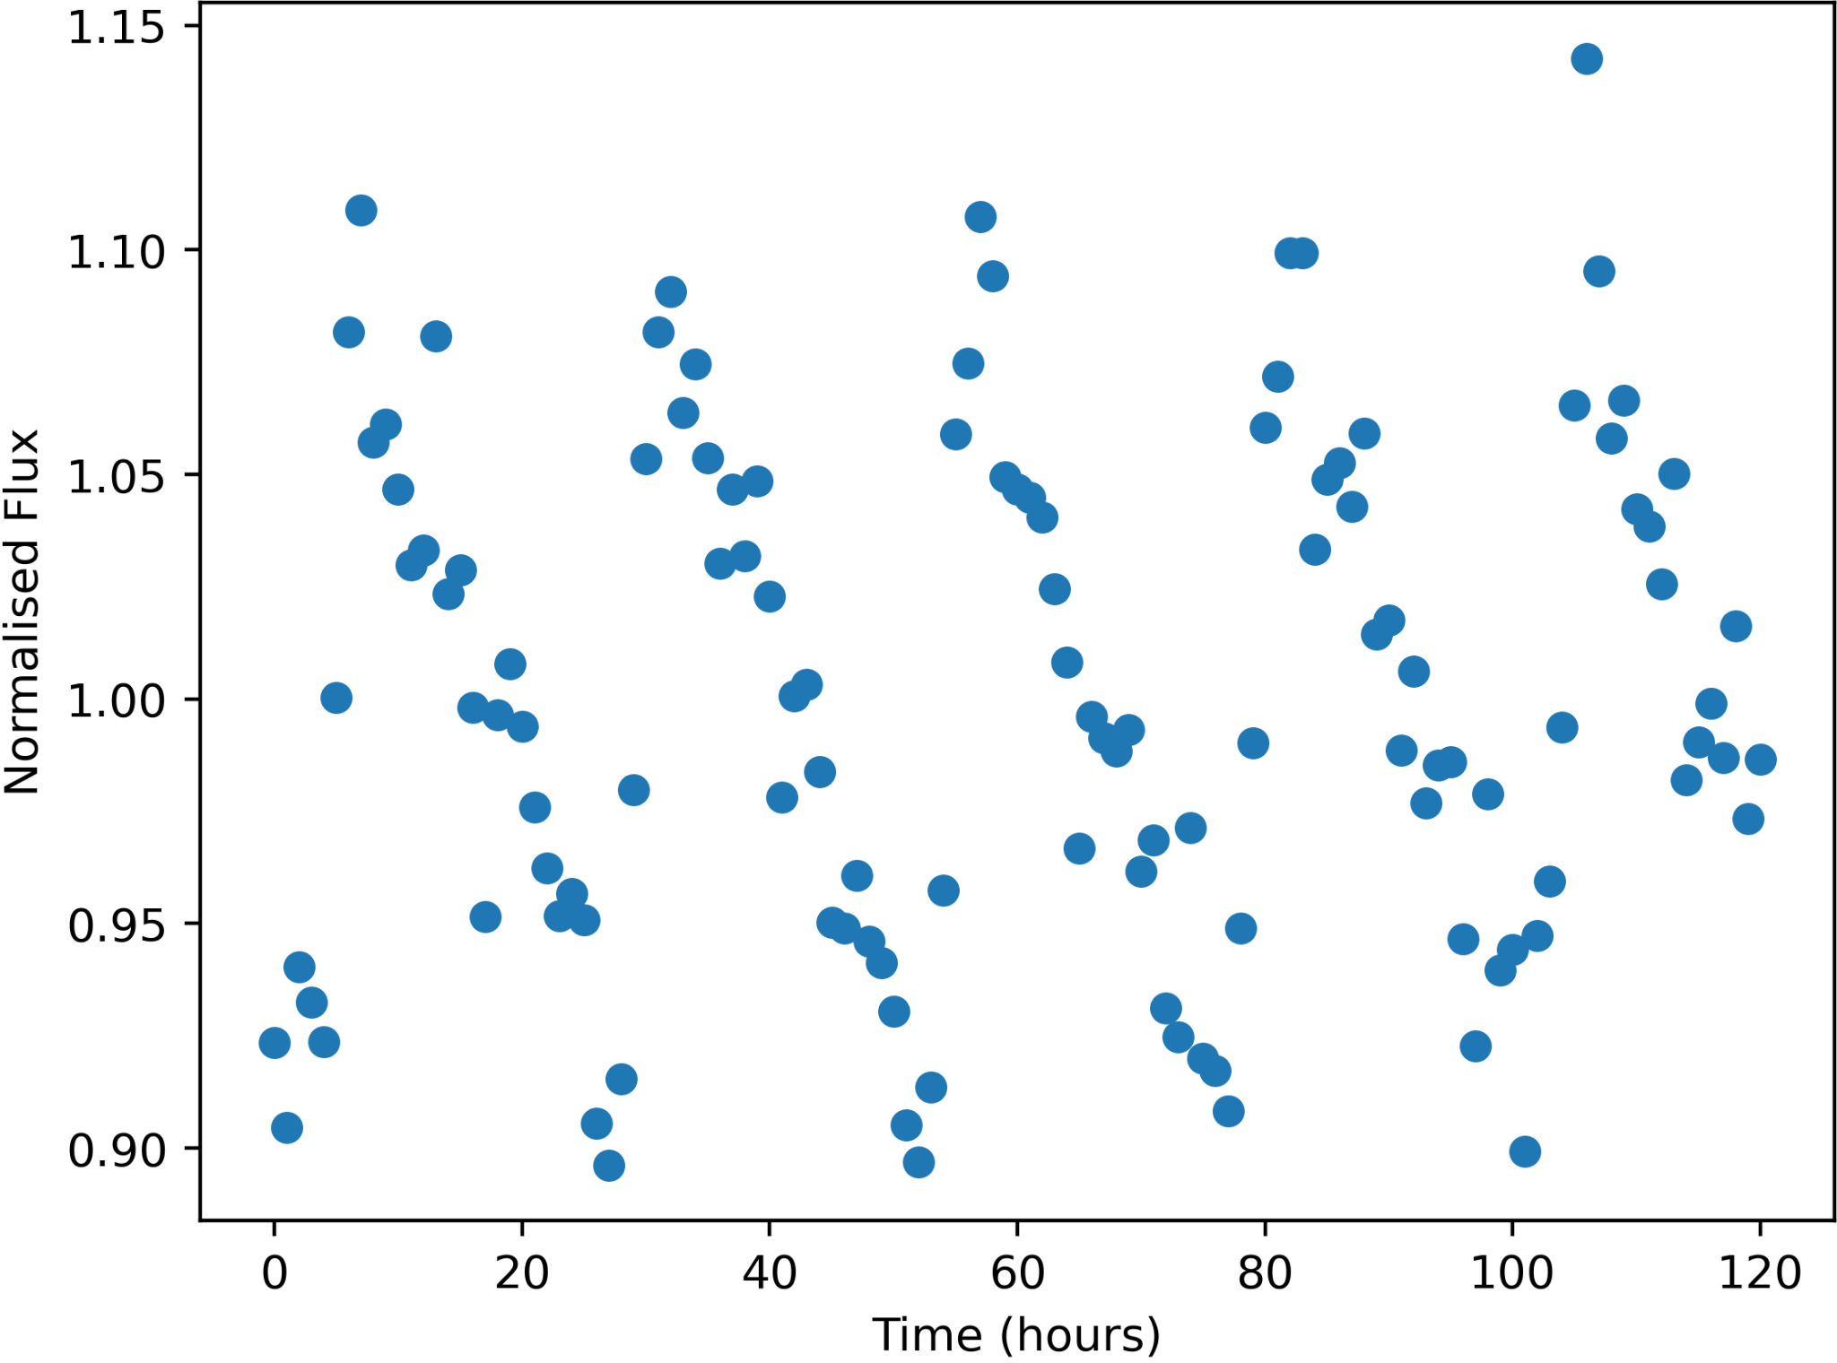
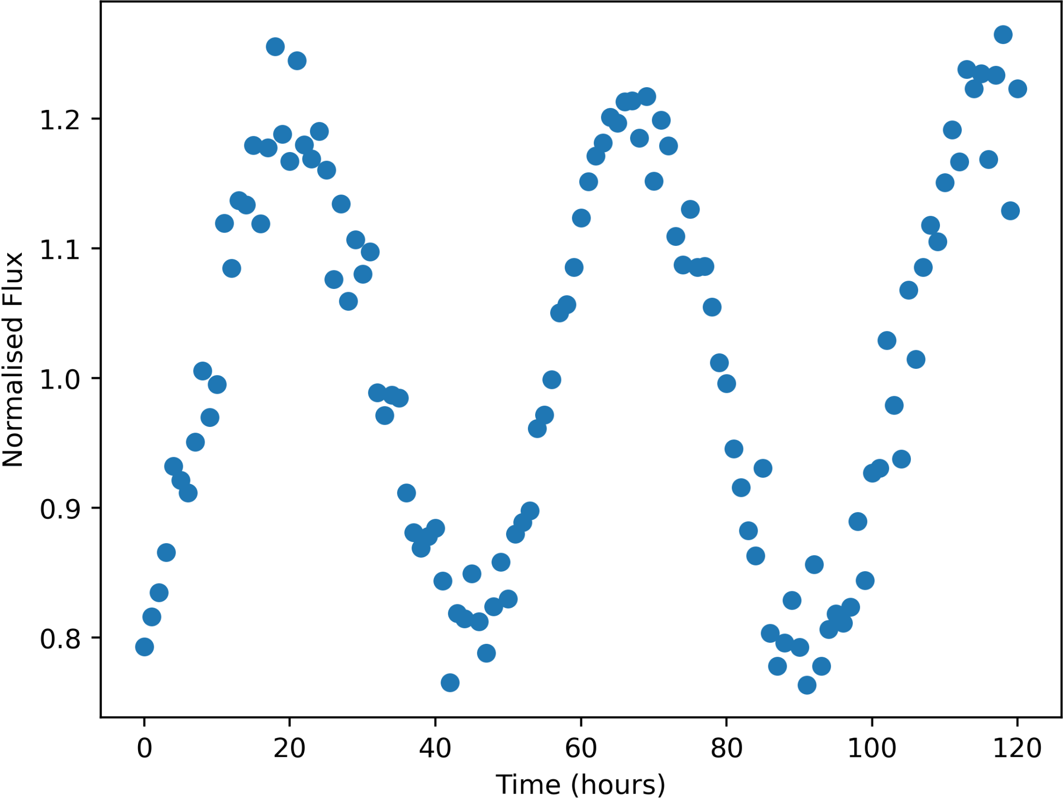
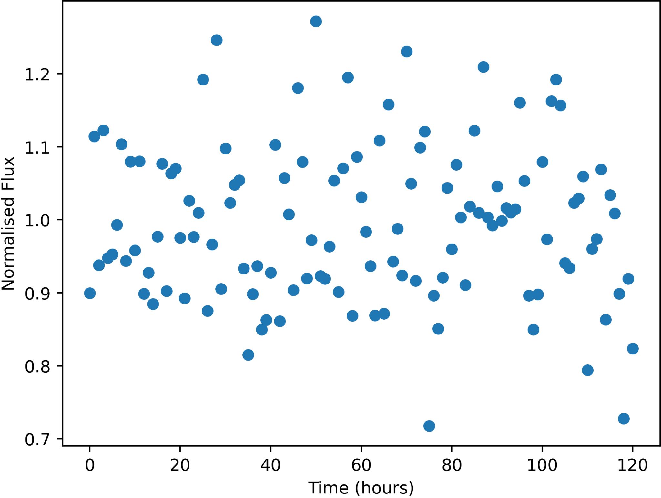
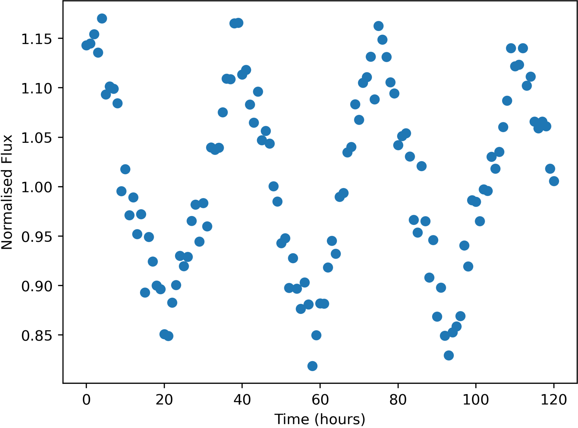
The Star Class — Variable Stars
Variable properties are generated at the universe level
Min 2, max 3 variable star types that lie on different spots on the HR diag.
Guaranteed to have short period (18-30 hours), and long period (38-55 hours)
33% chance to have very long period (75-100 hours)
3 valid light curves: Sine wave, triangular wave, and sawtooth wave.
Potential for noisy data too (lower left)

Slide 10
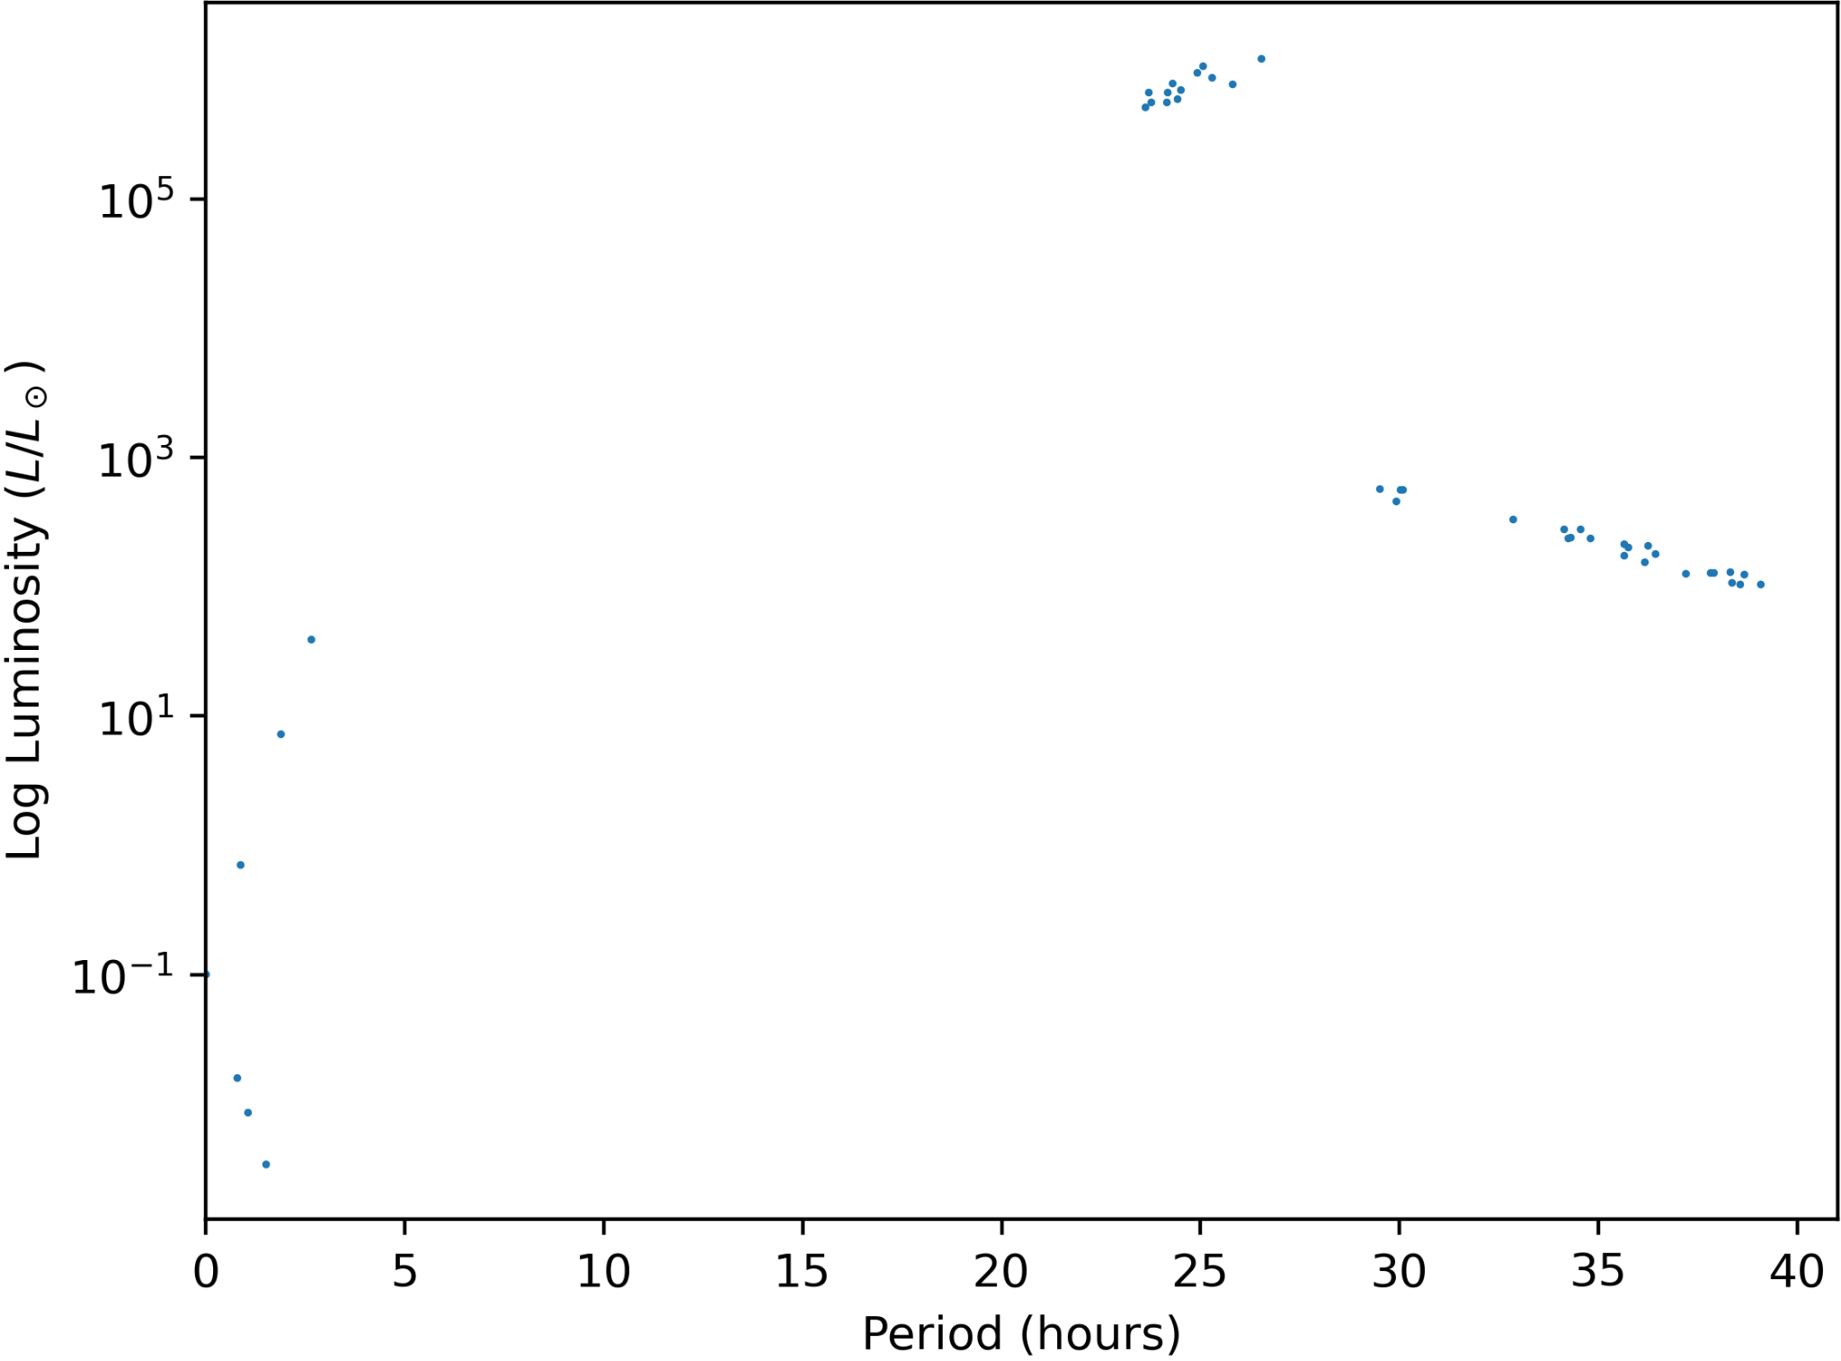
The Star Class — Variable Stars
Variable properties are generated at the universe level
Min 2, max 3 variable star types that lie on different spots on the HR diag.
Guaranteed to have short period (18-30 hours), and long period (38-55 hours)
33% chance to have very long period (75-100 hours)
3 valid light curves: Sine wave, triangular wave, and sawtooth wave.
Potential for noisy data too (lower left)
Right figure shows an example period-luminosity relation.
This is as close as two linear trends ever get in period!

Slide 11
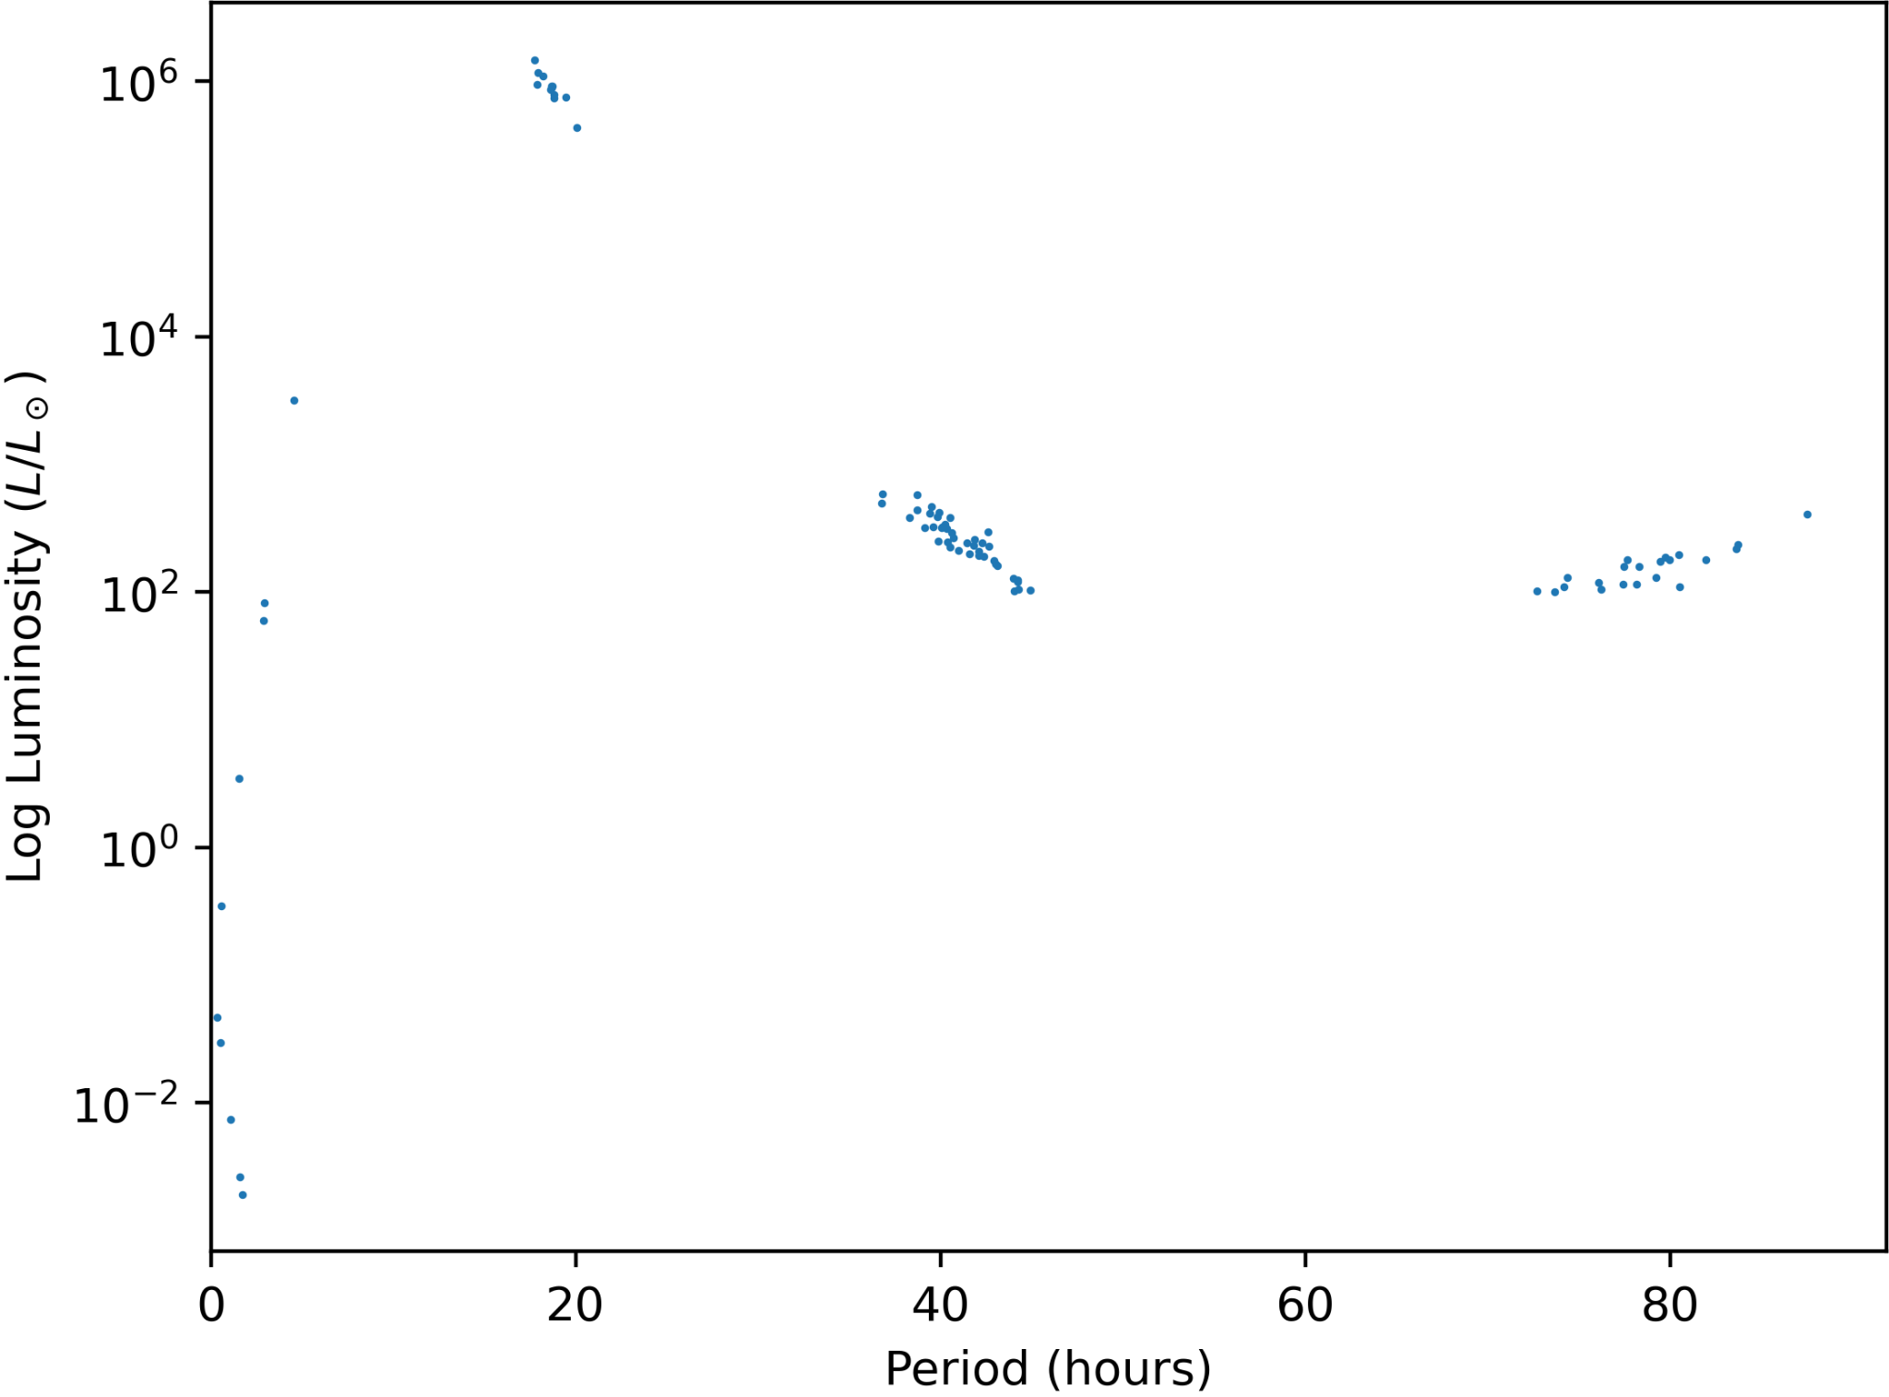
The Star Class — Variable Stars

Slide 12
The Star Class — Variable Stars on the HR Diagram
Short Period Variables
Longest Period Variables
Long Period Variables

Slide 13
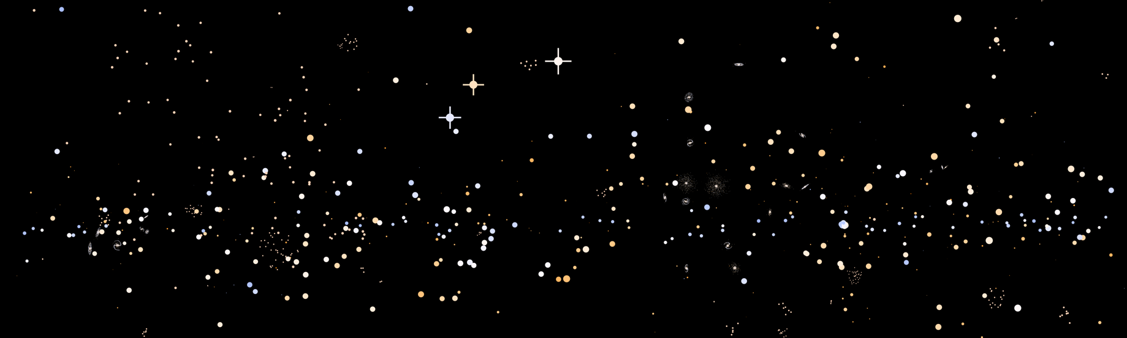
The Star Class — Universe Image
Brightest stars have makeshift diffraction spikes
Scale of each star in the image is based on a logarithmic scale of its flux
Colours of each star are taken from a table of blackbody colours given temperature (rounded to the nearest 100K)

Slide 14
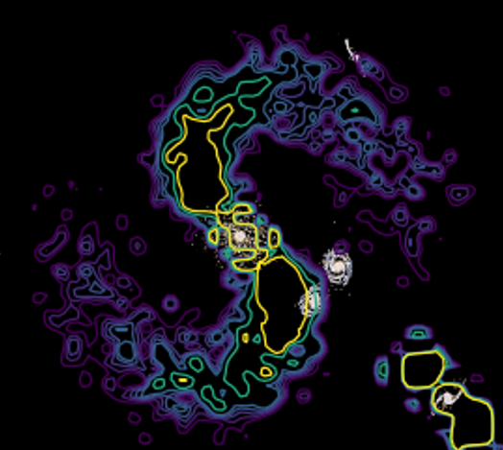
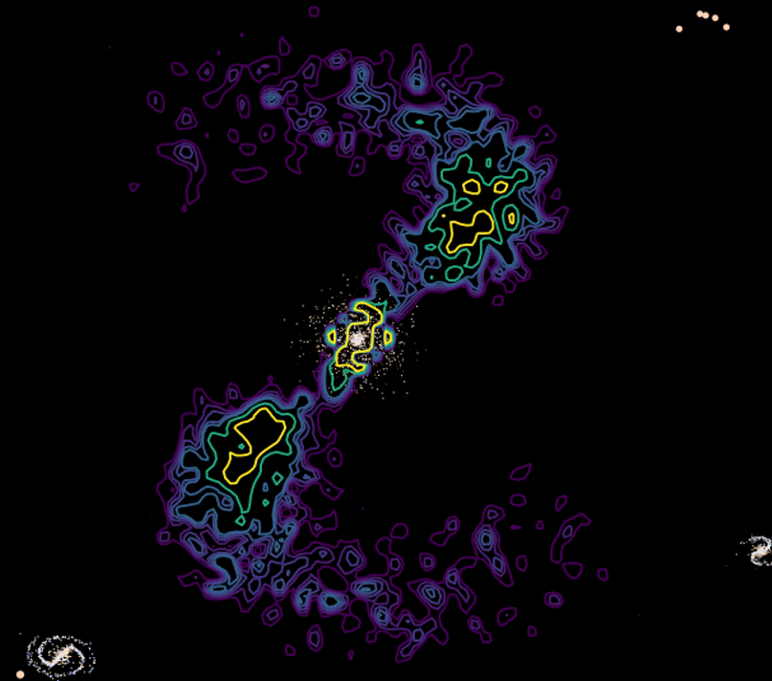
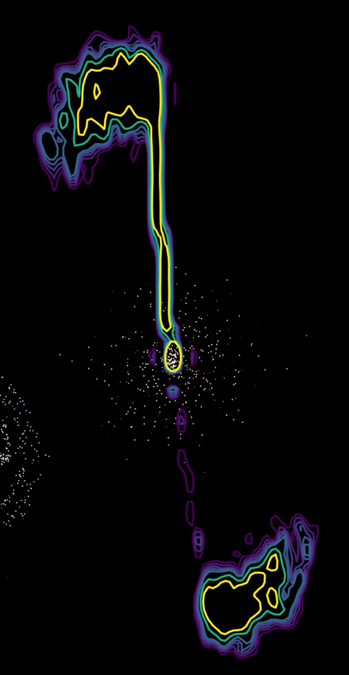
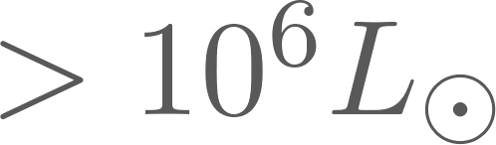
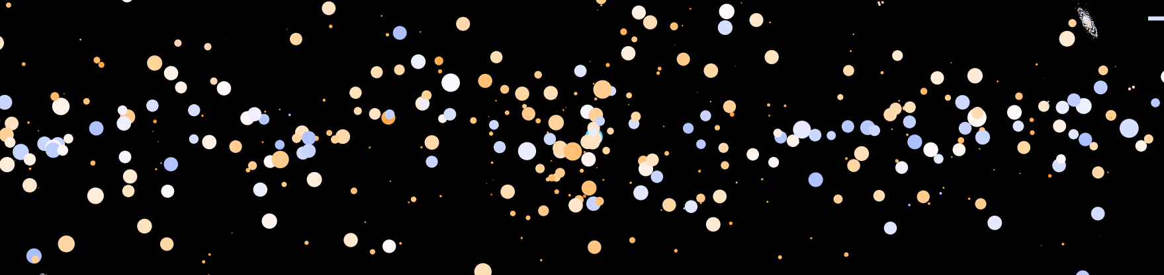

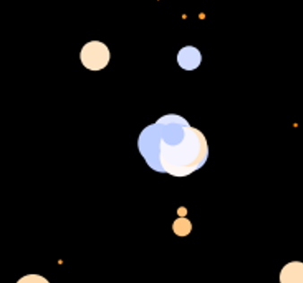
The BlackHole Class — Outline
Set at the universe level if galaxies have a ‘SMBH’ at their core
BH mass dependent on galaxy mass, with ellipticals having ~2 to 3 times more massive central black holes than spirals. Typically ~40 to 300 solar masses
BH have luminosity (as a proportion of Eddington luminosity). Proportion is chosen by how many stars are in the BH compact cluster
If luminosity , then radio lobes are generated
cD Galaxies will have FRI lobes (upper left), all others will have FRII lobes (upper right)
Purely qualitative at this stage
Black holes are also visible in the centers of galaxies (lower middle), as aqua coloured, bright stars

Slide 15
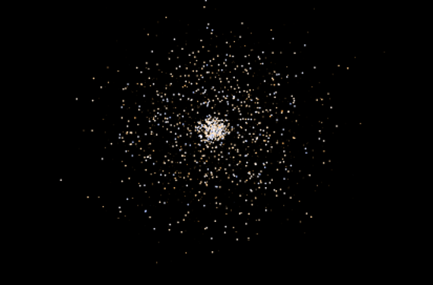
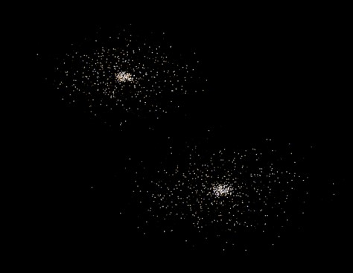
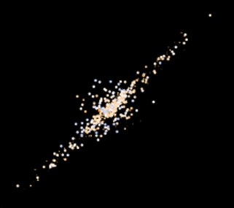
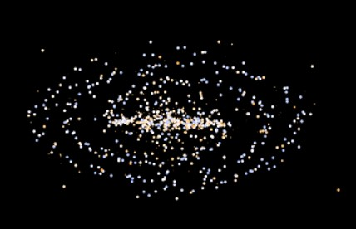
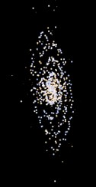
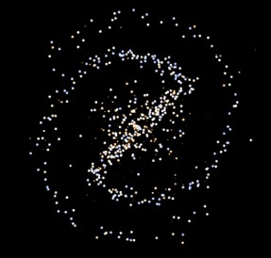
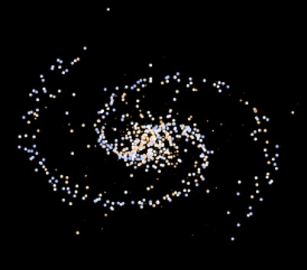
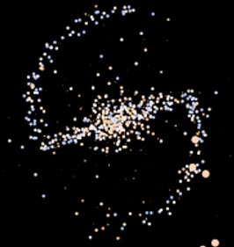
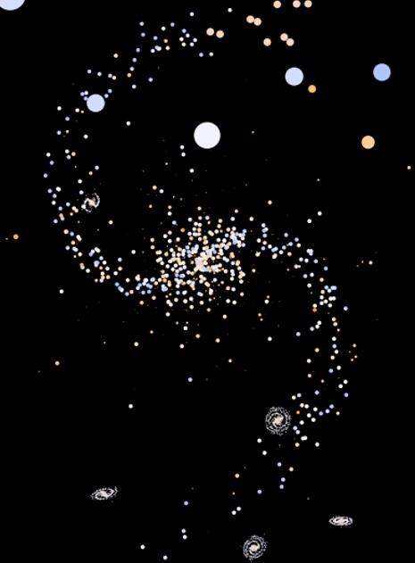
The Galaxy Class — Outline
cD Elliptical S0 SBa Sa SBb Sb SBc Sc
Elliptical and spiral galaxies simulated according to strict rules
Galactic bulge has (on average) lower mass, redder stars and so do Ellipticals
~70% of spirals will have central bars, containing redder stars
Spiral tightness determined randomly and uniformly
Rotation curves are simulated, with black holes and dark matter affecting the velocities too
Galaxies will typically have 800 stars (Sc types) up to ~2200 stars (cD types)
Star species dependent on location in galaxy
70pc (Sc) to 200pc (cD/E0) in radius
This class currently generates both resolved galaxies (top), and distant galaxies (which appear just as dots)

Slide 16
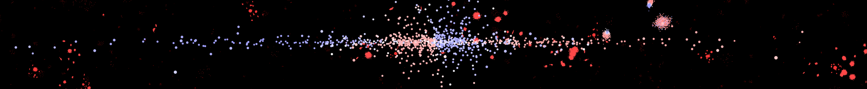
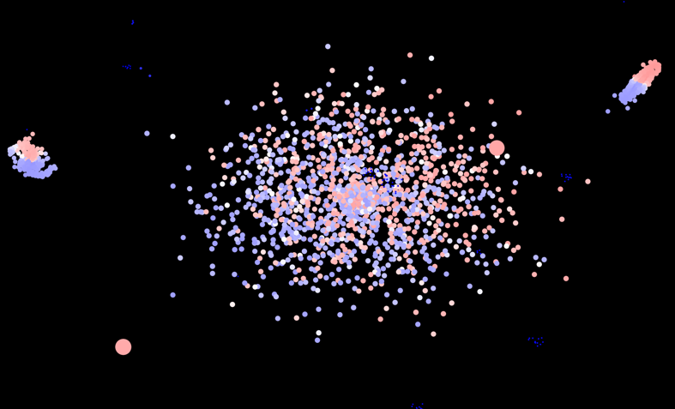
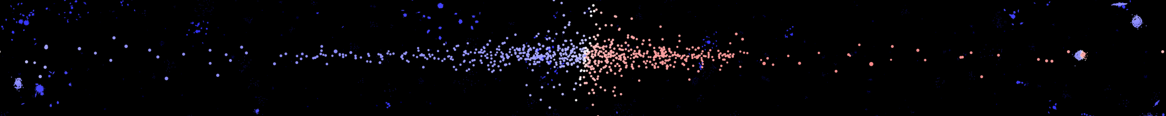
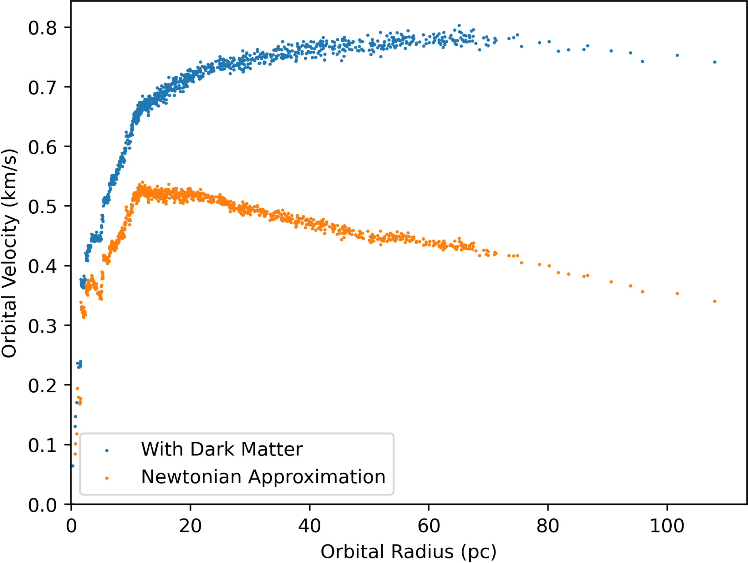
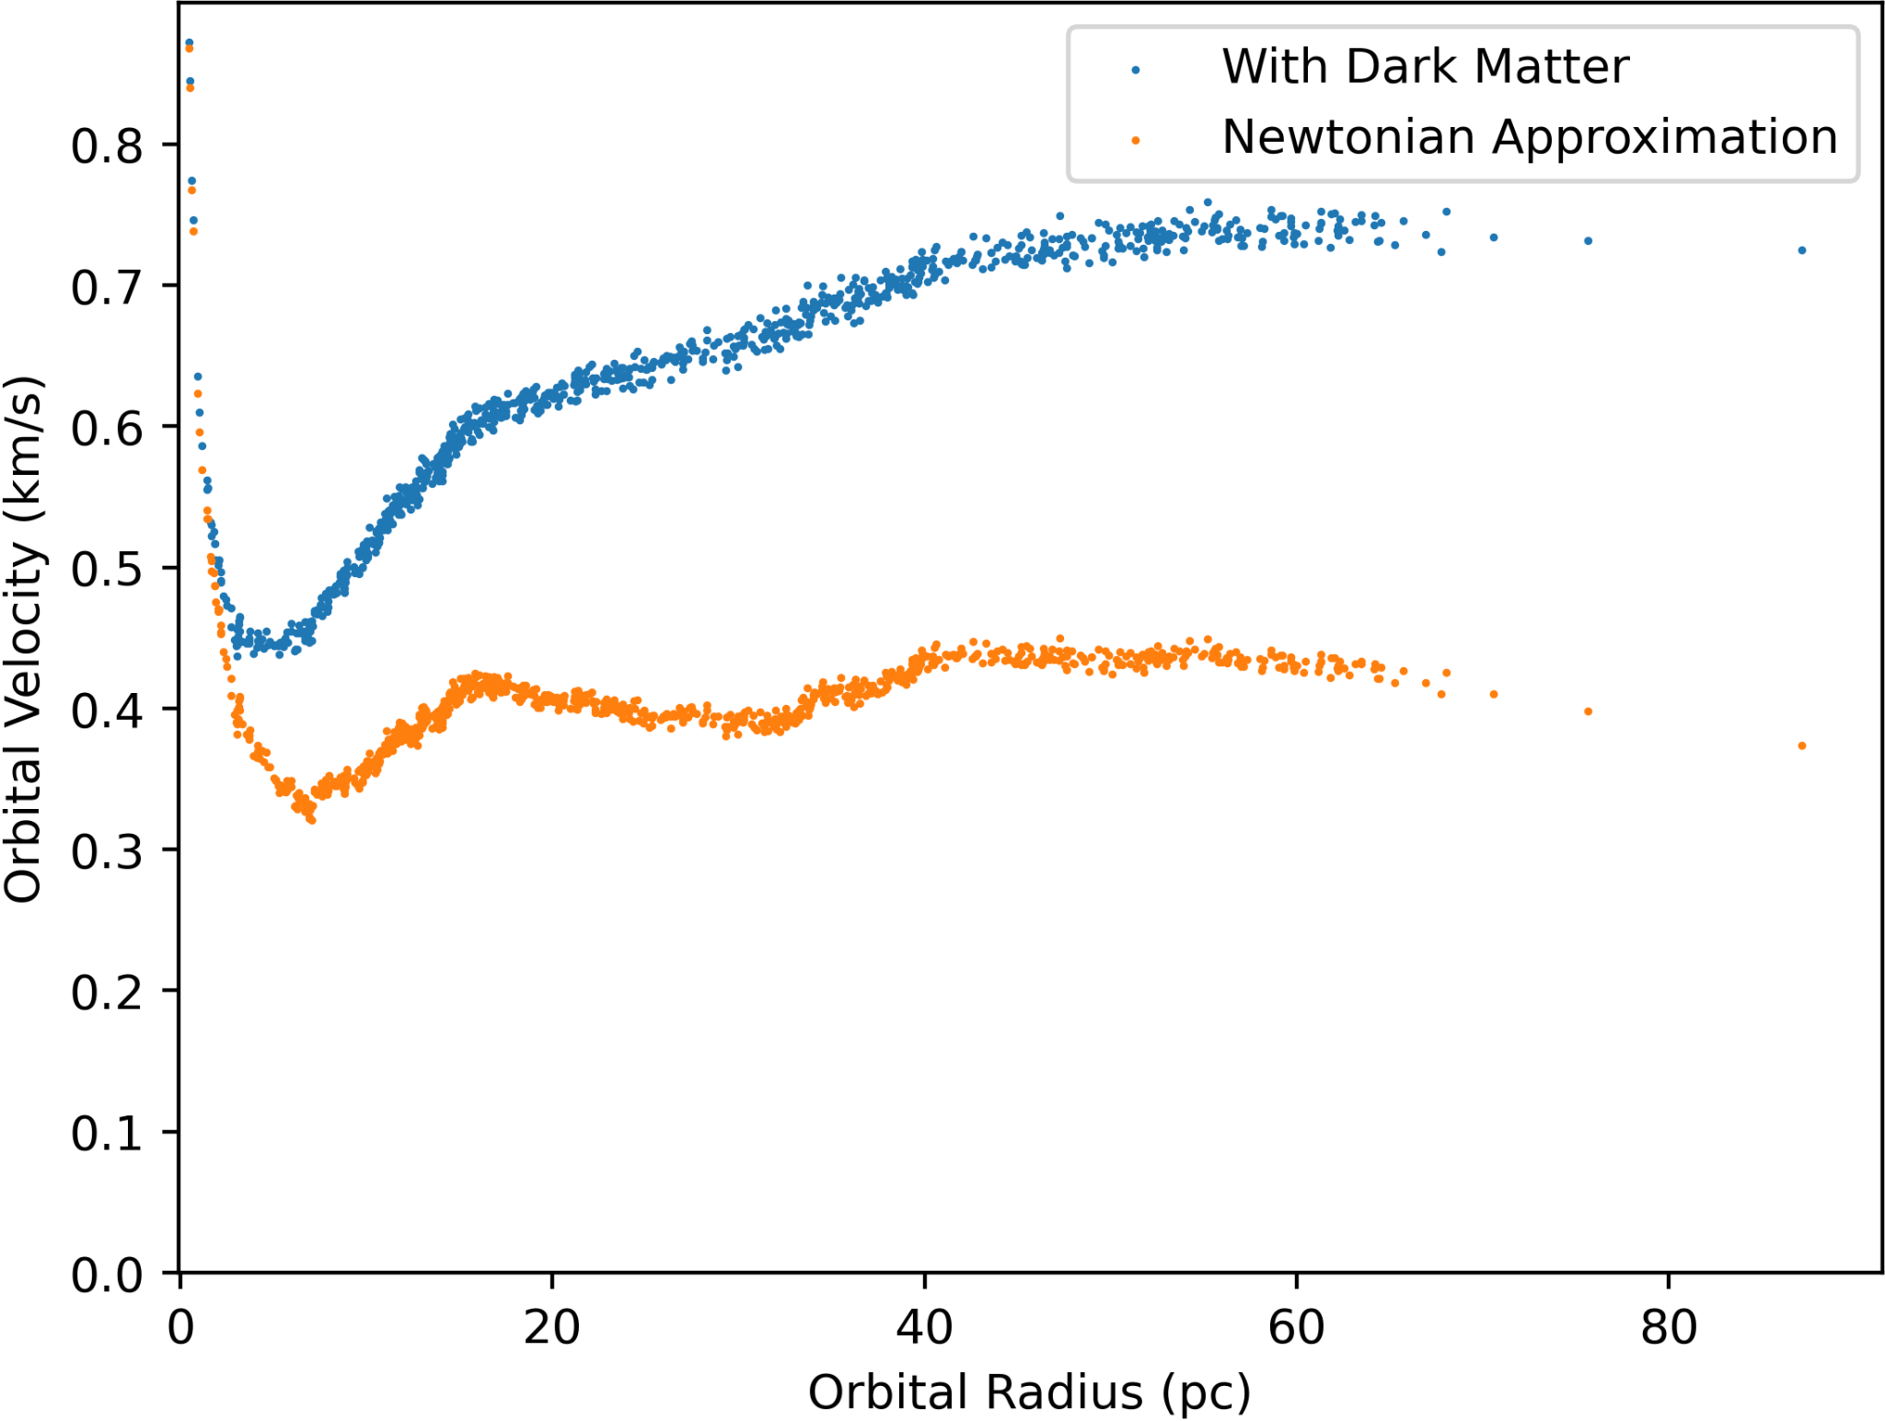
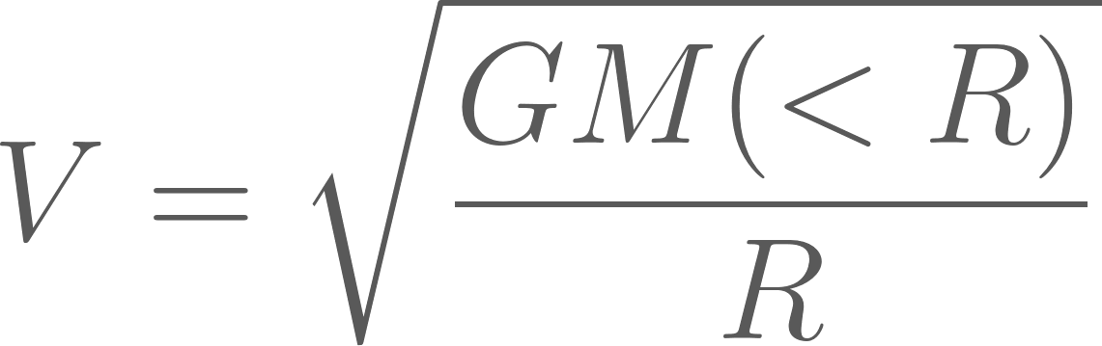
The Galaxy Class — Rotation Curves
Barred example:
Elliptical example:
Non-barred example:
Rotation curves are affected by central black holes, dark matter (via the Navarro-Frenk-White profile), and all of the other stars in the galaxy according to:
Elliptical galaxies characterised by a smooth curve (in magnitude), but star velocities have random direction in 3D space
No black hole (left), black hole present (right)

Slide 17
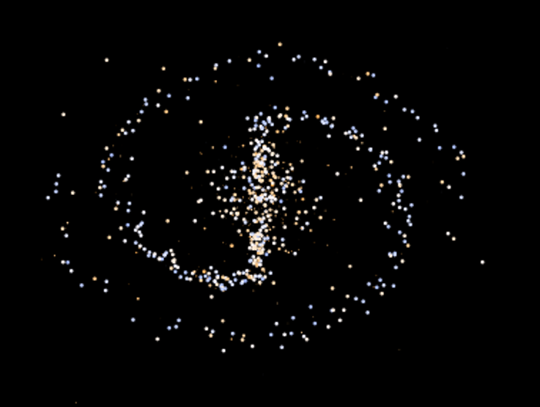
The Galaxy Class — Anatomy of a Spiral
Stars distributed according to a few distinct regions.
A central galactic bulge – redder, lower mass stars in an oblate spheroid
Central bar (if SB galaxy) – redder, lower mass stars in a cylindrical shape
Basic disk – low mass stars distributed approx. uniformly in a disk across the radius
Spiral arms – two spiral structures
Brighter (leading) structure full of massive, blue stars
Dimmer structure has some less massive stars, but generally more massive than bulge
If galaxy has black hole, a central compact cluster is generated
Typical SBb galaxy for reference

Slide 18
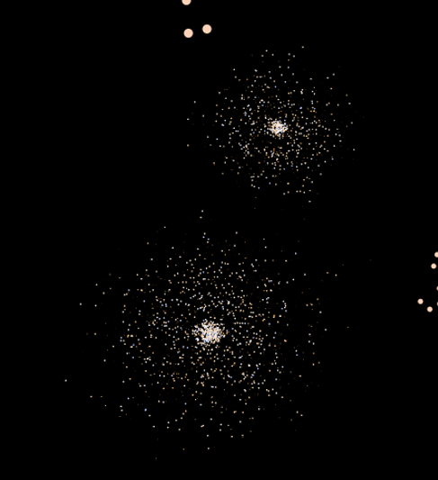
The Galaxy Class — Anatomy of an Elliptical
Very simple in generation
Composed of an central, spherical distribution and an outer, oblate distribution of stars
Stars are generated as ‘bulge’ population, so redder and lower mass
E0 are spherical, and ellipticals get progressively more oblate up to E7
cD are also spherical, just with ~30% more stars
No prolate/boxy ellipticals, but wouldn’t be hard to implement

Slide 19
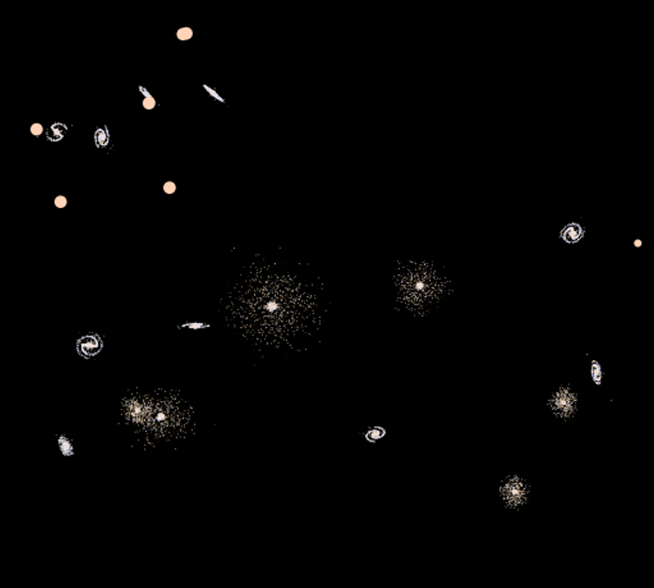
The GalaxyCluster Class — Outline
Galaxies are generated within clusters throughout the universe
Exponentially distributed population, with a mean of 8 galaxies
Galaxies spherically distributed within the cluster
Cluster radius dependent on population
If population is greater than 10, a cD galaxy is in the center of the cluster
Else if the population is greater than 5, an elliptical is guaranteed in the center
If the population is exactly 1, S0 galaxy is chosen
Elliptical galaxies more likely as you get closer to the center, and elliptical galaxies are less common in less populous clusters
If the universe has dark matter, then so do clusters

Slide 20
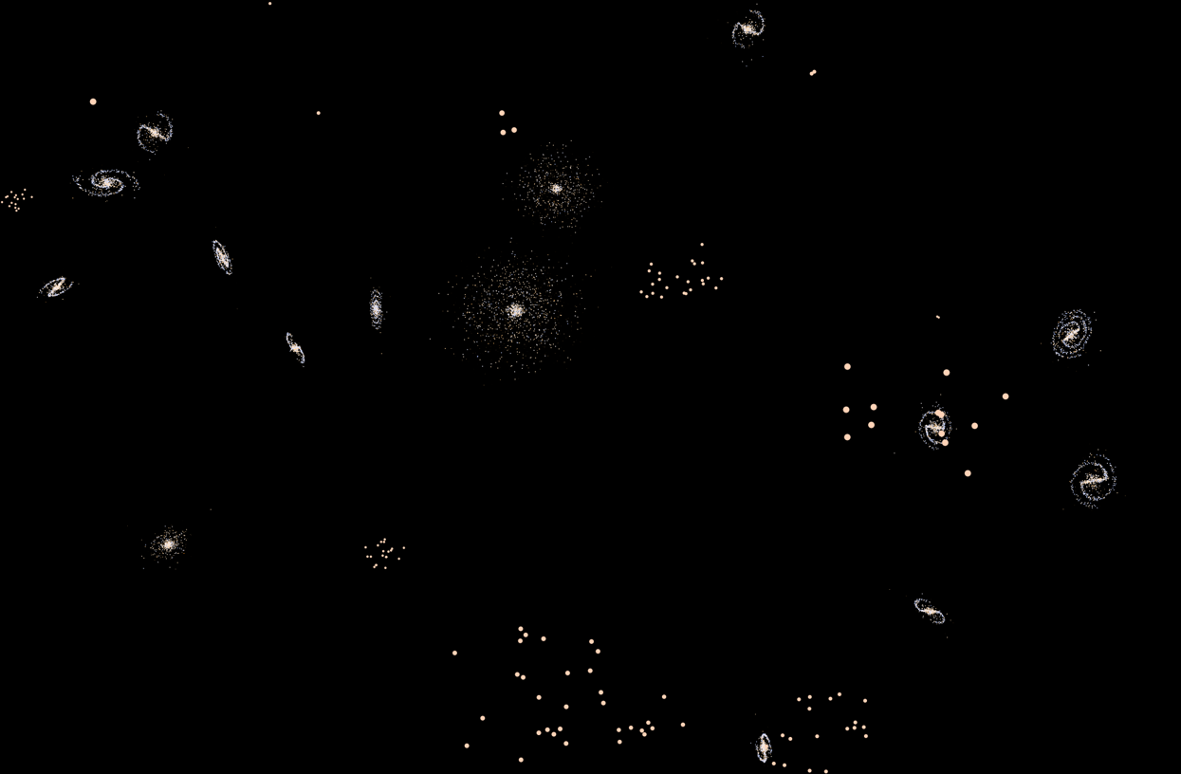
The GalaxyCluster Class — Close Example

Slide 21
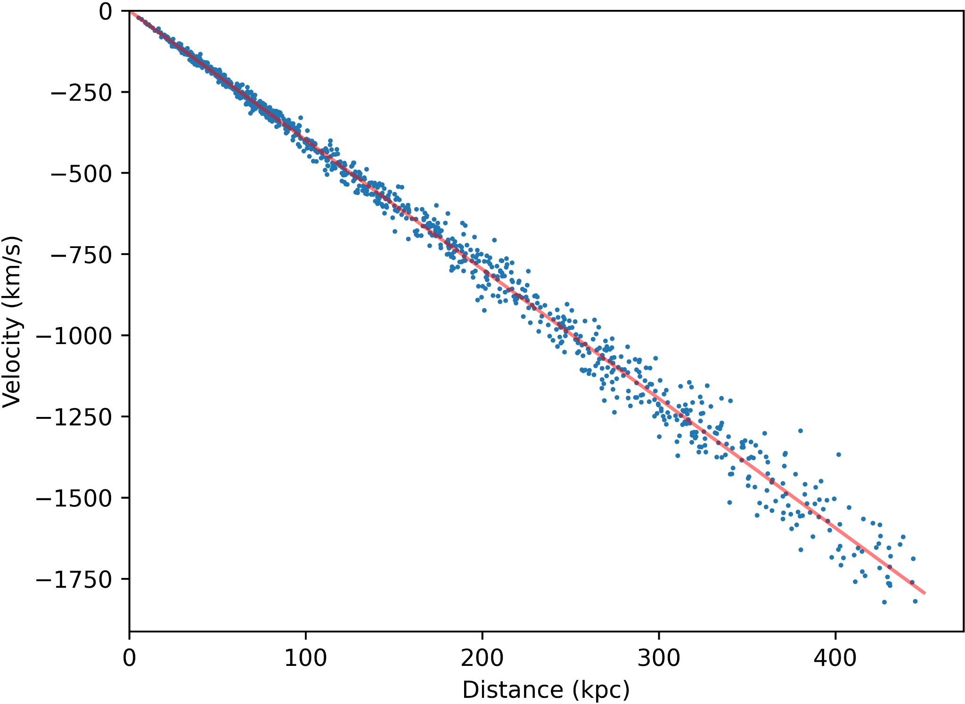
The Universe Class — Outline
This class chooses universal properties (variable stars, black holes, dark matter)
Also chooses locations of galaxy clusters
Currently, the likelihood of galaxy clusters increase exponentially up to 30kpc, then decrease exponentially to the universe radius (which is user-definable)
Hubble constant has random sign, and is between 1000 and 5000km/s/Mpc in magnitude
Supernovae hosts are chosen in the Universe class
Minimum of two in ‘resolved’ galaxies
Currently 55 hosts are chosen
Radial velocities of all objects are calculated here
Accounts for movement within galaxies, clusters, and the universe

Slide 22
The UniverseSim Class — Outline
This class outputs the data and generates graphs for the user
Universe properties
Universe picture
Radio overlay picture
Star data
Variable star data
Blackbody curves for star in local galaxy
Distant galaxy data
Supernova data
Doppler image
Black hole data
Rotation curves for resolved galaxies, and galaxy clusters
~5 minutes universe generation, ~3 minutes data saving

Slide 23
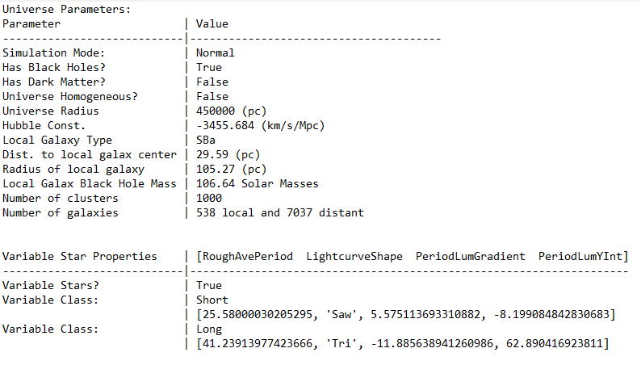
The UniverseSim Class — Universe Properties
Example of a Universe Properties file, effectively containing the answers for the universe

Slide 24
Future Work
Already implemented nebulosity for spiral galaxies – need to extend to all spiral types and ellipticals
Working on planetary nebulae, and in beginning stages of star forming nebulae
Some potential for qualitative analysis about the nature of stars and galaxies
Code naturally extends itself to accretion disks — AGN pictures?
Would love to implement binary/multiple star systems – provides an avenue to calculate individual star mass
Make code more efficient, and boost overall speed
Complete guide to analysis on the website

Slide 25
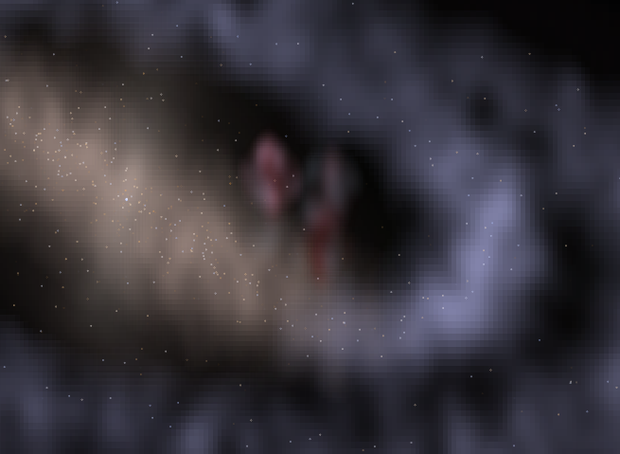
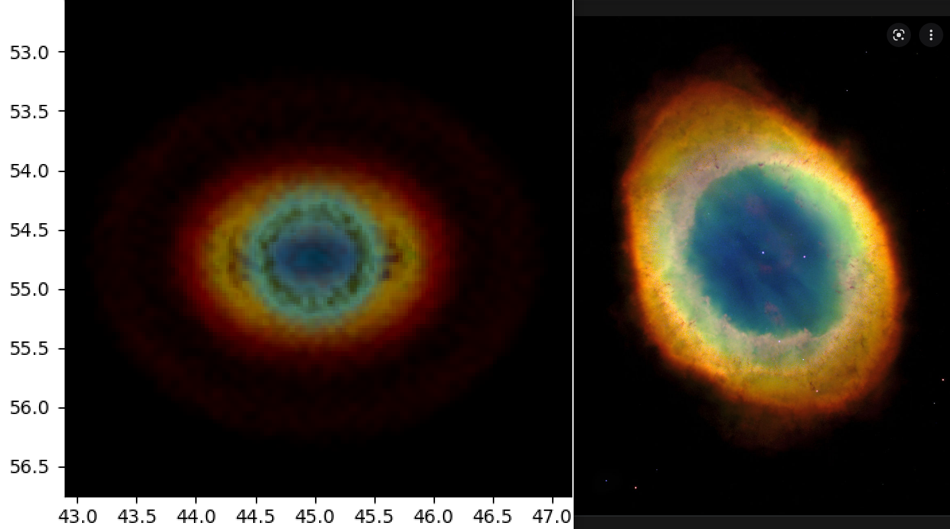
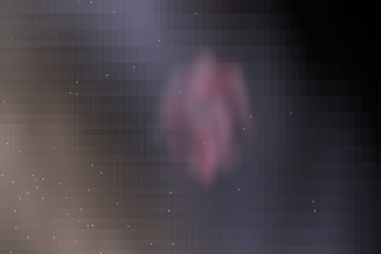
Future Work — Nebulae

Slide 26
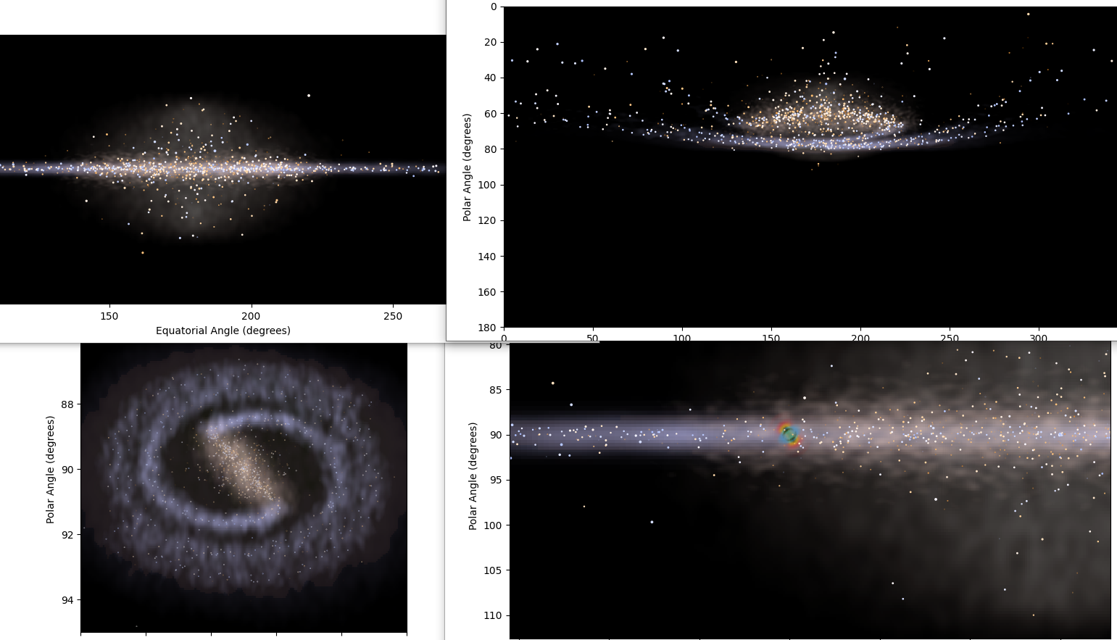
Future Work — Galaxy Nebulosity

Slide 27
Known Issues
The Hubble diagram has large variance at large distance – should be large variance at small distance
Currently no option for an anisotropic universe
Some implementation of seeds for RNG – not entirely consistent between generations
Distant galaxies have properties derived from tabulated values (with some RNG). Ideally, would have their own class with generation rules
Could use a speed boost
There’s lots of room to improve efficiency already
Unfortunately, irreducible 2 minutes to generate universe image
Considering fiddling with Cython, vectorisation, C++, JIT compiling, etc – I’d need to learn these from scratch
Some aspects of simulation still untested from a user perspective
Still testing actual distance ladder!
Haven’t tested BlackHole luminosity values yet

Slide 28
Final Points
Some functionality implemented to reduce galaxy populations and size
Untested, and I much prefer the more populous galaxies both aesthetically and practically
Functionality implemented to include black holes and dark matter only in some galaxies
Makes analysis much more difficult, so not suitable for PHYS3080
Wouldn’t be difficult to change the units of universe images (e.g. to right ascension and declination, or others)
MKDocs site up and running, with a guide to analysis of the data (very WIP) Link here: https://ryanwhite1.github.io/Simulated-Universe/
Link to GitHub repo, which has a tl;dr of this presentation: https://github.com/ryanwhite1/Simulated-Universe

Slide 29
Thank you for listening!

